Slide 1

Biostatistics
Week #16
6/7/2022

Slide 2
Ch 15 – Contingency Tables

Slide 3

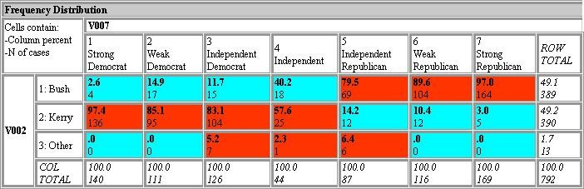
Outline
When working with nominal data (or categorical data) that have been grouped into categories, we often arrange the counts in a tabulated format known as contingency table.

Slide 4






In the simplest case, two dichotomous random variables are involved; the rows of the table represent the outcomes of one variable, and the columns represent the outcomes of the other one.
A contingency table is often referred as a
two-way frequency table too.

Slide 5

Testing a contingency table
Hypothesis testing can test a table to see whether a row variable is independent of its column variable.
H₀ assumes that column and row outcomes are independent.
A test statistic called χ² (read as kai- square, and spelled as Chi-square) is computed, which is a random variable having its own probability density function.

Slide 6


Example #1
100 individuals are randomly sampled from a very large population.
Male vs female
Right-handed vs left-handed.
Here the two dichotomous random variables are “gender” (taking two values “male” and “female”) and “handedness” (taking two values “left-handed” and “right-handed”)

Slide 7

 | Right- handed | Left- handed
Males | 43 | 9
Females | 44 | 4
THEN?

Slide 8


Cont’d
Usually we are interested in knowing whether there is a correlation between gender and handedness (left-handed or right-handed). That is, are men more left-handed (or right- handed) than women?
It may certainly look true from the numbers shown below. Is it statistically sound?
 | Right-handed | Left-handed | TOTALS
Males | 43 (82.7%) | 9 (17.3%) | 52
Females | 44 (91.7%) | 4 (8.3%) | 48
TOTALS | 87 (87.0%) | 13 (13.0%) | 100

Slide 9









Cont’d
The significance of the difference between the two proportions can be assessed (or the association being measured) with a variety of statistical tests including Pearson's chi-square test, the G-test, Fisher's exact test, and Barnard's test, provided the entries in the table represent individuals randomly sampled from the population about which we want to draw a conclusion.

Slide 10

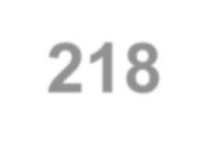
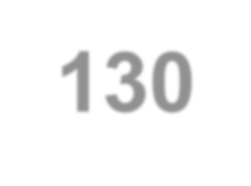
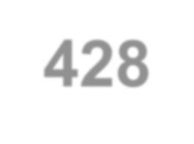
Example #2
Consider the following 2 by 2 table displaying the study investigating the effectiveness of bicycle safety helmets in preventing head injuries.
Head Injury | Wearing Helmet
 | Yes | No
Yes | 17 | 218
No | 130 | 428

Slide 11


Cont’d
To examine the effectiveness of helmet wearing, we test the null hypothesis at
α=0.05 level of significance:
H₀: The proportion of persons suffering head injuries for people who wore helmets at the time of accident is the same as the people who did not wear helmet. (有戴與 沒戴, 在意外發生時, 都一樣會受傷)
H_{A}: There is a difference between wearing and not wearing helmet

Slide 12


“Expected” Contingency Table
We will first reconstruct the “original” contingency table based on the null hypothesis. Resulting table is called an “expected” contingency table.
That is, the proportions of individuals experiencing head injuries among those wearing helmets and those not wearing helmets are identical in this “expected” contingency table.

Slide 13
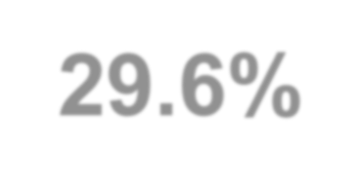
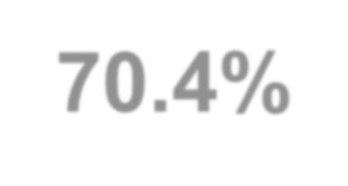
We begin by creating the total column. The purpose is to get the percentages of head injury or not from the total. Here we have roughly a 3:7 ratio,
Head Injury | Wearing Helmet |  | Total
 | Yes | No
Yes | 17 | 218 | 235 (29.6%)
No | 130 | 428 | 558 (70.4%)

Slide 14


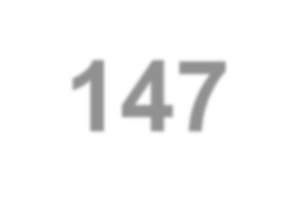
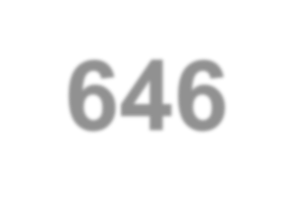
We next create the total row, and know that we have 147 people wearing helmet and 646 did not. Here we know the total number of subjects are 793 (from either the total column or total row).
Head Injury | Wearing Helmet |  | Total
 | Yes | No
Yes | 17 | 218 | 235 (29.6%)
No | 130 | 428 | 558 (70.4%)
Total | 147 | 646 | 793

Slide 15






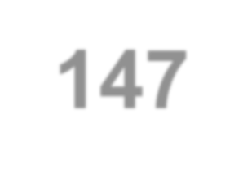
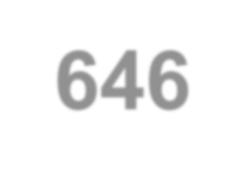
If we did not know the counts in the 4 blue cells, can you fill out something into them based on the 3:7 ratio in the total column?
What hint did I give to you?
What would you do?
What’s in your mind when you did this?
Head Injury | Wearing Helmet |  | Total
 | Yes | No
Yes | ? | ? | 235 (29.6%)
No | ? | ? | 558 (70.4%)
Total | 147 | 646 | 793

Slide 16


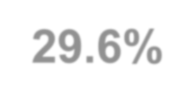


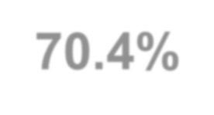
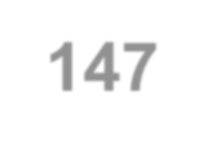



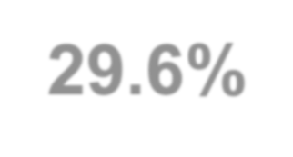


Head Injury | Wearing Helmet |  | Total
 | Yes | No
Yes | ? | ? | 235 (29.6%)
No | ? | ? | 558 (70.4%)
Total | 147 | 646 | 793
Consider the following two groups of individuals:
For 147 wearing helmets, we’d expect:
147×29.6%=43.6 get their heads injured; and 147×70.4%=103.4 not injured.
For 646 not wearing helmets, we’d expect:
646×29.6%=191.4 get their heads injured; and 646×70.4%=454.6 not injured.

Slide 17
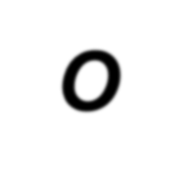




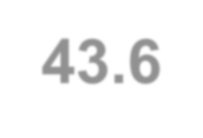
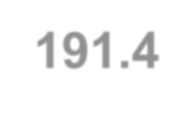
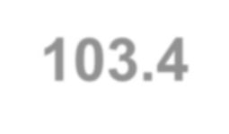
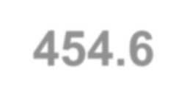



Head Injury | Wearing Helmet |  | Total
 | Yes | No
Yes | 17 | 218 | 235
No | 130 | 428 | 558
Total | 147 | 646 | 793
Original contingency
table; denoted by O.
Head Injury | Wearing Helmet |  | Total
 | Yes | No
Yes | 43.6 | 191.4 | 235.0
No | 103.4 | 454.6 | 558.0
Total | 147.0 | 646.0 | 793.0
Expected contingency table, provided that the null hypothesis is true, denoted by E.
We want to know if the deviations of these 4 cells between these two tables, that is, O−E, are too large to be attributed to chance alone.

Slide 18
Chi-Square (χ²) Test
The chi-square test compares the observed frequencies (counts) in each category of the contingency table with the expected frequencies given that the null hypothesis is true.
It is denoted by the following formula, where rc is the number of cells in the table.
_{X} 2 _{= ∑} i i
rc
(O − E )²
E_{i}
i=1

Slide 19





Cont’d
The probability distribution of this sum is approximated by a chi-square (χ²) distribution with (r−1)(c−1) degrees of freedom, with a table of r rows and c columns.
So a 2 by 2 table will have df= (2−1)(2−1)=1, and 3 by 4 table will have df= (3−1)(4−1)=6.
A chi-square distribution is not symmetric.
The test is one-tailed.
See the resemblance to F-test?

Slide 20

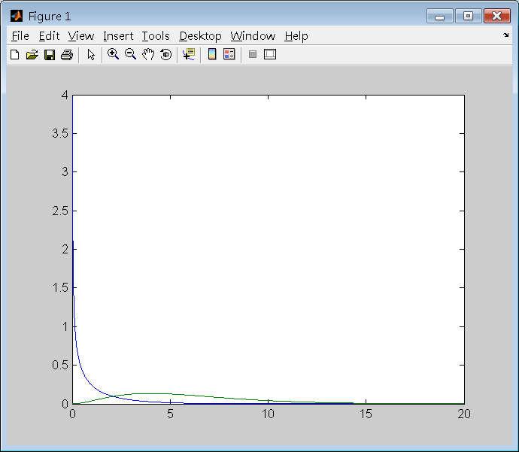
>> help chi2pdf
CHI2PDF Chi-square probability density function (pdf). Y = CHI2PDF(X,V) returns the chi-square pdf with V degrees of freedom at the values in X.
>> x=0:0.01:20;
>> y1=chi2pdf(x,1);
>> y6=chi2pdf(x,6);
>> plot(x,y1,x,y6)
>>
Y1: blue line Y6: green line

Slide 21


>> help chi2inv
CHI2INV Inverse of the chi-square cumulative
distribution function (cdf).
X = CHI2INV(P,V) returns the inverse of the chi-square cdf with V degrees of freedom at the values in P.
χ² =3.8415 cuts off right-handed 5% off the df=1 curve.
χ² =12.5916 cuts off the right-handed 5% off the df=6 curve.
>> chi2inv(0.95,1) ans =
3.8415
>> chi2inv(0.95,6) ans =
12.5916
>>

Slide 22
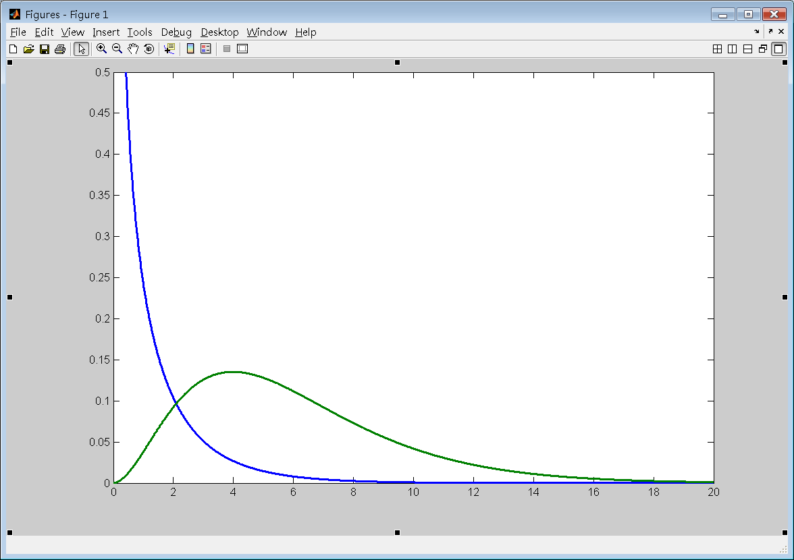
Farther to the right signifies the deviation between O and E, suggesting the row-column independence is weaker.
df=1
df=6
χ² =12.5916
χ² =3.8415

Slide 23
Head Injury | Wearing Helmet |  | Total |  | Head Injury | Wearing Helmet |  | Total
 | Yes | No |  |  |  | Yes | No
Yes | 17 | 218 | 235 |  | Yes | 43.6 | 191.4 | 235.0
No | 130 | 428 | 558 |  | No | 103.4 | 454.6 | 558.0
Total | 147 | 646 | 793 |  | Total | 147.0 | 646.0 | 793.0
_{= ∑} i i ₌
_{χ} 2
rc
(O − E )²
(17 − 43.6)²
(218 −191.4)²
+
E_{i}
43.6
191.4
i=1
₊ (130 −103.4)²
₊ (428 − 454.6)²
103.4
= 28.3246
454.6

Slide 24
We see that χ² =28.3246 is far to the right of
χ² =3.8415 that cuts off 5% off the df=1 curve.
We thus reject the null hypothesis at
α=0.05.
That is, there indeed exists a significant difference of wearing helmet or not regarding head injuries.
p-value = 1.0258e-007
>> 1-chi2cdf(28.3246,1) ans = 1.0258e-007
>>

Slide 25








Can we view by “rows” rather than “columns”?
Head Injury | Wearing Helmet |  | Total
 | Yes | No
Yes | 17 | 218 | 235
No | 130 | 428 | 558
Total | 147(18.5%) | 646(81.5%) | 793
For 793 people, 18.5% wore helmet and 81.5% (or the remaining people out of the aforementioned 18.5%) did not.

Slide 26
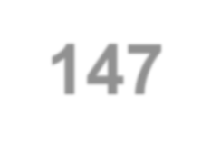
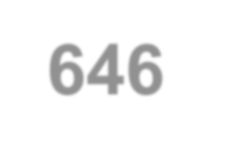




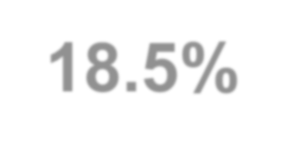
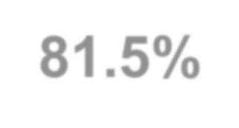

Head Injury | Wearing Helmet |  | Total
 | Yes | No
Yes | ? | ? | 235
No | ? | ? | 558
Total | 147(18.5%) | 646 (81.5%) | 793
Consider the following two groups of individuals :
For 235 having head injury, we’d expect:
235×18.5%=43.5 wore helmet; and 235×81.5%=191.5 did not.
For 558 having no head injury, we’d expect:
558×18.5%=103.2 get their heads injured; and 558×81.5%=454.8 not injured.

Slide 27




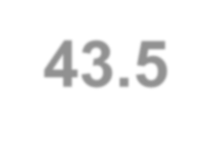
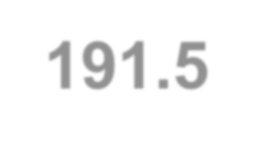
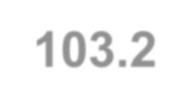
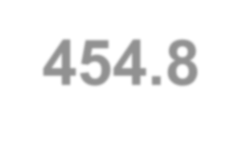
Expected contingency table computed by proportion from “Total” column.
Head Injury | Wearing Helmet |  | Total
 | Yes | No
Yes | 43.6 | 191.4 | 235.0
No | 103.4 | 454.6 | 558.0
Total | 147.0 | 646.0 | 793.0
Head Injury | Wearing Helmet |  | Total
 | Yes | No
Yes | 43.5 | 191.5 | 235.0
No | 103.2 | 454.8 | 558.0
Total | 147.0 | 646.0 | 793.0
Expected contingency table computed by proportion from “Total” row.
We can see the two expected tables “the same” except some round-off digits.

Slide 28
Example #3
Instead of 2 by 2 table we saw earlier, we now have a 2 by 3 table to consider.
Results from 575 autopsies (解剖驗屍) were compared
to the cause of death listed on the certificates (死亡證明).
Hospital | Death Certificate Status |  |  | Total
 | Confirmed. Accurate. | Inaccurate. No change. | Incorrect. Recoding.
A (Community H) | 157 | 18 | 54 | 229
B (University H) | 268 | 44 | 34 | 346
Total | 425 | 62 | 88 | 575

Slide 29

Cont’d
We would like to determine whether the results of this study suggest different practices in completing death certificates at the two hospitals.
The null hypothesis could be either of the following two (at significance level 0.05):
H₀: within each category of certificate status, the proportions of death certificates in hospital A are identical.
H₀: there is no association between hospital and death certificate status.

Slide 30
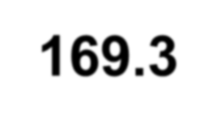
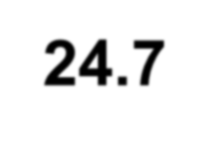
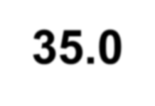
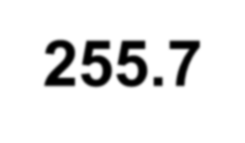
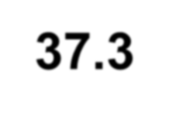
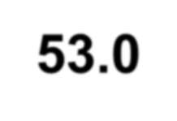
Building E based on row-proportions of total.
Hospital | Death Certificate Status |  |  | Total
 | Confirmed. Accurate. | Inaccurate. No change. | Incorrect. Recoding.
A (Community H) | 157 | 18 | 54 | 229 (39.83%)
B (University H) | 268 | 44 | 34 | 346 (60.17%)
Total | 425 | 62 | 88 | 575
We would have the expected counts as:
Hospital | Death Certificate Status |  |  | Total
 | Confirmed. Accurate. | Inaccurate. No change. | Incorrect. Recoding.
A (Community H) | 169.3 (425x39.83%) | 24.7 | 35.0 | 229
B (University H) | 255.7 | 37.3 | 53.0 | 346
Total | 425.0 | 62.0 | 88.0 | 575

Slide 31
Building E based on column-proportions of total.
Hospital | Death Certificate Status |  |  | Total
 | Confirmed. Accurate. | Inaccurate. No change. | Incorrect. Recoding.
A (Community H) | 157 | 18 | 54 | 229
B (University H) | 268 | 44 | 34 | 346
Total | 425 (73.91%) | 62(10.78%) | 88(15.31%) | 575
We could also have the expected counts as:
Hospital | Death Certificate Status |  |  | Total
 | Confirmed. Accurate. | Inaccurate. No change. | Incorrect. Recoding.
A (Community H) | 169.3 (73.91%x229) | 24.7 | 35.0 | 229
B (University H) | 255.7 | 37.3 | 53.0 | 346
Total | 425.0 | 62.0 | 88.0 | 575

Slide 32
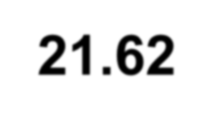

Conclusion
The chi-square can be computed as 21.62.
This allows us to reject the null hypothesis (p-value = 1-chi2cdf(21.62,2) = 2.0197e-005)
That is, hospital A and hospital B are indeed different.
For example, it is clear (from the original table) that hospital A apparently issued more incorrect certificates that required recoding, suggesting that a community hospital requires improving its practice in issuing a death certificate.
Hospital | Death Certificate Status |  |  | Total
 | Confirmed. Accurate. | Inaccurate. No change. | Incorrect. Recoding.
A (Community H) | 157 | 18 | 54 | 229
B (University H) | 268 | 44 | 34 | 346
Total | 425 | 62 | 88 | 575

Slide 33
In-class practice #1
Is left-handedness related to gender, at a level of significance set to 0.05?
 | Right-handed | Left-handed
Males | 43 | 9
Females | 44 | 4

Slide 34
Original table:
 | Right-handed | Left-handed | TOTALS
Males | 43 (82.7%) | 9 (17.3%) | 52
Females | 44 (91.7%) | 4 (8.3%) | 48
TOTALS | 87 (87.0%) | 13 (13.0%)) | 100
Expected table:
 | Right-handed | Left-handed | TOTALS
Males |  |  | 52
Females |  |  | 48
TOTALS | 87 (87.0%) | 13 (13.0%)) | 100
Chi-square = ? P-value = ?
Conclusion = ?

Slide 35
Original table:
 | Right-handed | Left-handed | TOTALS
Males | 43 (82.7%) | 9 (17.3%) | 52
Females | 44 (91.7%) | 4 (8.3%) | 48
TOTALS | 87 (87.0%) | 13 (13.0%) | 100
Expected table:
 | Right-handed | Left-handed | TOTAL S
Males | E1=87*52/100 | E2=13*52/100 | 52
Females | E3=87-E1 | E4=13-E2 | 48
TOTALS | 87 (87.0%) | 13 (13.0%) | 100
Chi-square = ? P-value = ?
Conclusion = ?

Slide 36
Original table:
 | Right-handed | Left-handed | TOTALS
Males | 43 (82.7%) | 9 (17.3%) | 52
Females | 44 (91.7%) | 4 (8.3%) | 48
TOTALS | 87 (87.0%) | 13 (13.0%)) | 100
Expected table:
 | Right-handed | Left-handed | TOTAL S
Males | E1=45.24 | E2=6.76 | 52
Females | E3=41.76 | E4=6.24 | 48
TOTALS | 87 (87.0%) | 13 (13.0%) | 100
Chi-square = ? P-value = ?
Conclusion = ?

Slide 37
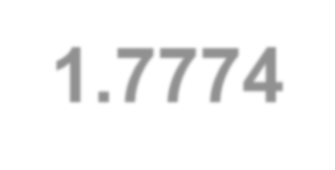
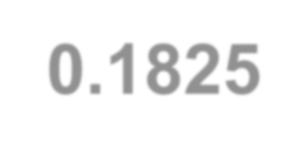
>> O=[43 9 44 4];
>> E=[45.24 6.76 41.76 6.24];
>> (O-E).^2./E
ans = 0.1109
>> X2=sum(ans) X2 = 1.7774
0.7422 0.1202 0.8041
>> 1-chi2cdf(X2,1) ans = 0.1825
>>
Chi-square statistic = 1.7774. The P-value is 0.1825, which greater than 0.05. We thus do not reject the null hypothesis, which claims no association between gender and handedness.

Slide 38
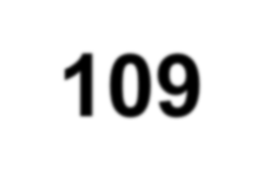

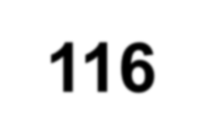
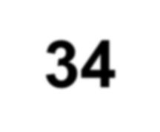
In-class practice #2
An outbreak of gastroenteritis – an inflammation of the membranes of the stomach and small intestine, was recorded following a lunch served in the cafeteria.
Is having sandwich a cause for sickness, at level significance set to 0.05?
 | Had sandwich
 | Yes | No
Sick | 109 | 4
Not sick | 116 | 34

Slide 39
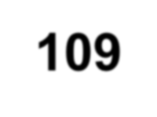

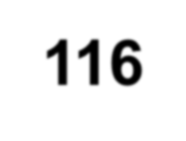
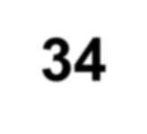
 | Had sandwich |  | Total
 | Yes | No
Sick | 109 | 4 | 113
Not sick | 116 | 34 | 150
Total | 225 | 38 | 263
Original table
 | Had sandwich |  | Total
 | Yes | No
Sick |  |  | 113
Not sick |  |  | 150
Total | 225 | 38 | 263
Expected table
Chi-square = ? P-value = ?
Conclusion?

Slide 40


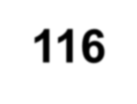

 | Had sandwich |  | Total
 | Yes | No
Sick | 109 | 4 | 113
Not sick | 116 | 34 | 150
Total | 225 | 38 | 263
 | Had sandwich |  | Total
 | Yes | No
Sick | E1=225*113/263 | E2=113-E1 | 113
Not sick | E3=225-E1 | E4=38-E2 | 150
Total | 225 | 38 | 263
Chi-square = ? P-value = ?
Conclusion?

Slide 41
 | Had sandwich |  | Total
 | Yes | No
Sick | 109 | 4 | 113
Not sick | 116 | 34 | 150
Total | 225 | 38 | 263
 | Had sandwich |  | Total
 | Yes | No
Sick | E1=96.6730 | E2=16.3270 | 113
Not sick | E3=128.3270 | E4=21.6730 | 150
Total | 225 | 38 | 263
Chi-square = ? P-value = ?
Conclusion?

Slide 42
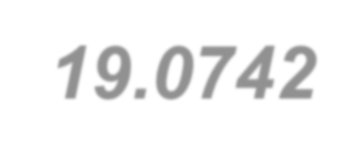
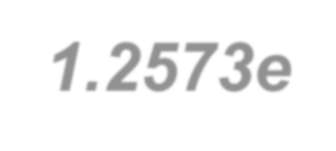


>> O=[109 4 116 34];
>> E=[96.673 16.327 128.327 21.673];
>> (O-E).^2./E
ans = 1.5718 9.3070 1.1841 7.0113
>> X2=sum(ans) X2 = 19.0742
>> 1-chi2cdf(X2,1) ans = 1.2573e-005
>>
Chi-square statistic = 19.0724. The p-value is small enough (p < 0.001) to reject the null hypothesis. We then link the sickness with having sandwich.

